Slide 1
NLP Project 1
程智聪 韩冬 张坚

Slide 2
Agenda
Data Preprocessing
Feature Selecting
Classifying
Result Analyzing
Summary

Slide 3
Data Preprocessing
XML library: XOM 1.1
Missing lexical-sample.dtd
Missing POS tags
  na, nx, Ug, …
Customized POS tag: *
Handling subword
-Xms128M -Xmx512M

Slide 4
Data Preprocessing
Handling multiple target items in the context
Handling punctuation
面临我国心脑血管疾病发病和死亡率逐年上升的严重趋势，现任中国<head>中医</head>研究院长城医院院长的周文志教授历时30余年艰辛探索，采用中医中药方法治疗和预防心脑血管疾病取得显著成果。
钻研中医理论，试图从前人
v
n
n
w
*
*
*

Slide 5
Feature Selecting
IncludeTokenPreOffset = 1
IncludeTokenPostOffset = 1
吴宏权<head>使</head>出全身
StartOffset = -1
0
EndOffset = 1
nr,v,吴,宏权,出,全身,use

Slide 6
Classifying
Data mining library
  Weka 3.6, maxent 20041229
Classifier
  MLP
    L: 0.6 H:12, 4, (adaptive) M: 0.9
  SMO
    NormalizedPolyKernel C:1.4
  NaiveBayes
  MEM
    g: 20

Slide 7
Result Analyzing
68%
Only POS
 | NaiveBayes | SMO | MLP
Range：-30 | 0.560427807 | 0.580748663
Range：-31 | 0.628877005 | 0.664171123
Range：-32 | 0.639572193 | 0.659893048
Range：-33 | 0.636363636 | 0.673796791
Range：-20 | 0.56684492 | 0.562566845
Range：-21 | 0.639572193 | 0.653475936
Range：-22 | 0.657754011 | 0.670588235
Range：-23 | 0.648128342 | 0.68342246
Range：-10 | 0.561497326 | 0.580748663
Range：-11 | 0.652406417 | 0.682352941 | 0.61
Range：-12 | 0.652406417 | 0.671657754
Range：-13 | 0.648128342 | 0.681283422
Range：01 | 0.580748663 | 0.586096257
Range：02 | 0.583957219 | 0.609625668
Range：03 | 0.581818182 | 0.618181818

Slide 8
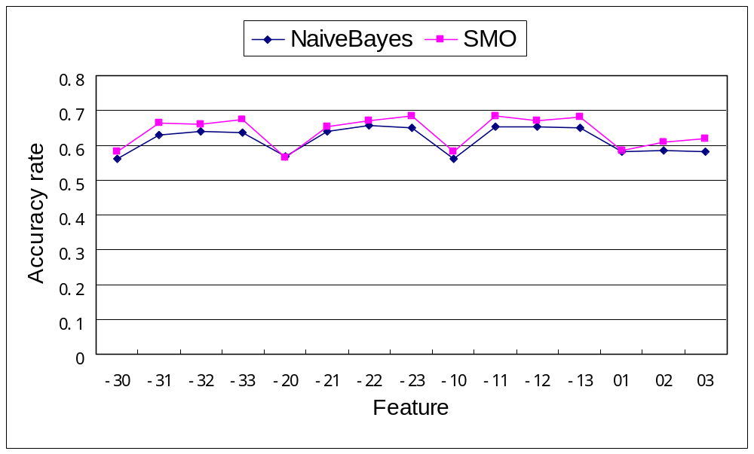
Result Analyzing
Only POS (con’t)
Context

Slide 9
Result Analyzing
Including tokens
Feature: -1 2 1 3
Algorithm Precision | SMO | NaiveBayes | MEM
P_{mir} | 71.44% | 66.63% | 71.87%
P_{mar} | 74.39% | 70.19% | 75.38%

Slide 10
Result Analyzing
Including tokens (con’t)
Feature: -1 1 1 2
Algorithm Precision | SMO | NaiveBayes | MEM
P_{mir} | 72.09% | 69.51% | 71.23%
P_{mar} | 75.30% | 73.04% | 75.00%

Slide 11
Result Analyzing
Punctuation optimization
Feature: -1 2 1 3
 | SMO | NaiveBayes | MEM
P_{mir} Before |  |  | 69.52%
P_{mir} After | 71.44% | 66.63% | 71.87%
Improvement |  |  | 2.35%

Slide 12
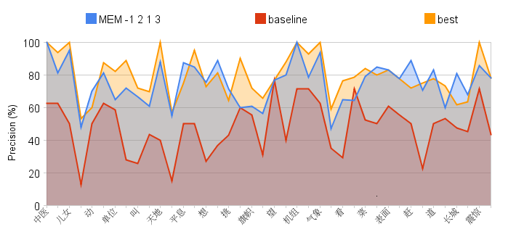
Result Analyzing
Performance

Slide 13
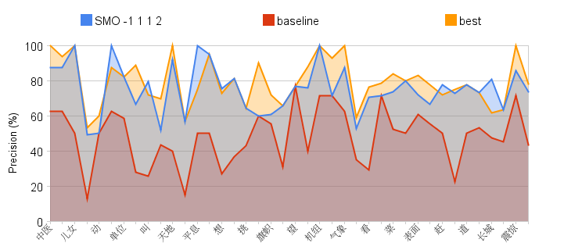
Result Analyzing
Performance (con’t)

Slide 14
Summary
Context is important
Less is better
Post POS/token features are more important
Punctuation matters
Possible improvements
  Typical words in sentence as features
  Collocations as features

Slide 15
Q & A
Thanks

